Slide 1
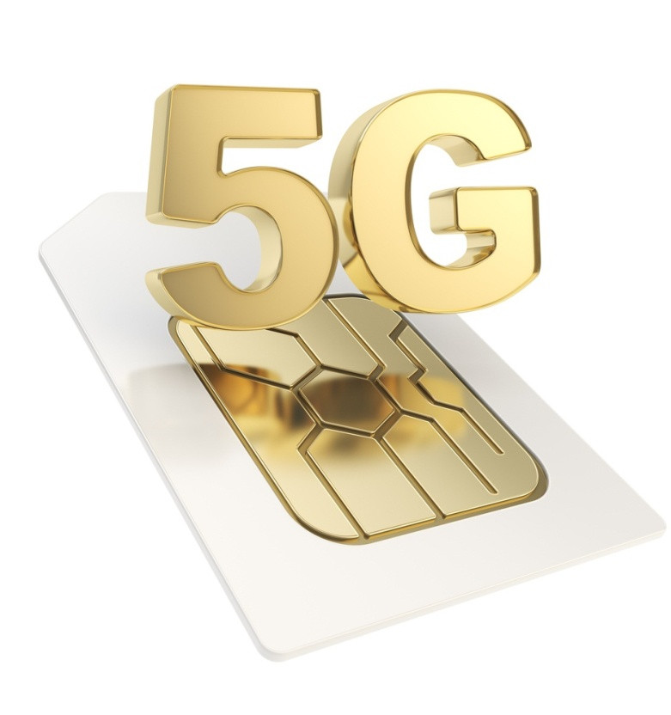
Mobile
Technology

Slide 2
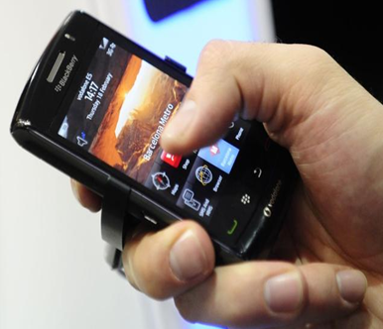
What is 5G?
5G Wireless: 5th generation wireless technology
Can be called REAL wireless world
Has incredible transmission speed
Concept is only theory not
Complete wireless communication with almost no limitations real.

Slide 3

What does it offer?
Worldwide cellular phones
Extraordinary data capabilities
High connectivity
More power & features in hand held phones
Large phone memory, more dialing speed, more clarity in audio & video

Slide 4
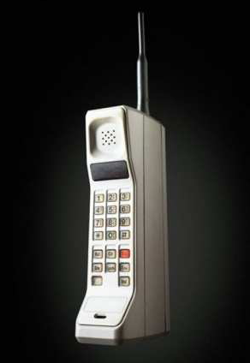
1G
Developed in 1980s & completed in
early 1990s
Based on analog system
Speed up to 2.4 kbps
AMPS (Advance Mobile Phone System) was launched by the US & it was the 1G mobile system
Allows user to make voice calls in 1 country

Slide 5
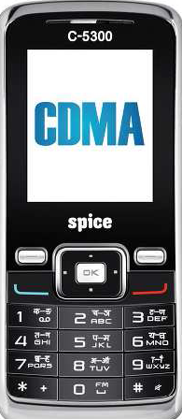
2G
Developed in late 1980s & completed in
late 1990s
Based on digital system
Speed up to 64 kbps
Services such are digital voice & SMS with more clarity
Semi global facility
2G are the handsets we are using today, with 2.5G
having more capabilities

Slide 6
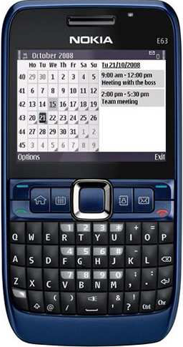
3G
Developed between late 1990s & early 2000s until present day
Transmission speed from 125 kbps to 2 Mbps
Superior voice quality
Good clarity in video conference
E-mail, PDA, information surfing, on-line shopping/ banking, games, etc.
Global roaming

Slide 7
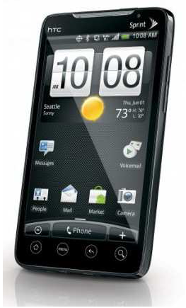
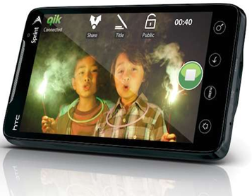
4G
Developed in 2010
Faster & more reliable
Speed up to 100 Mbps
High performance
Easy roaming
Low cost

Slide 8
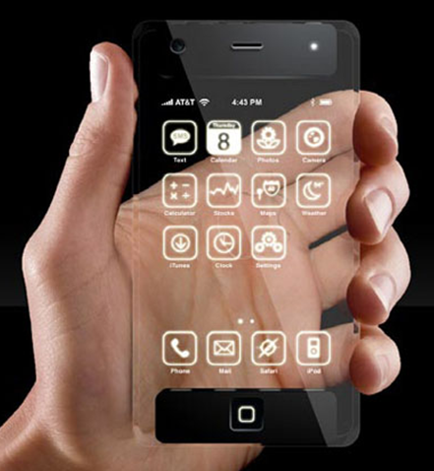
5G
Next major phase of mobile telecommunication & wireless system
10 times more capacity than others
Expected speed up to 1 Gbps
More faster & reliable than 4G
Lower cost than previous

Slide 9
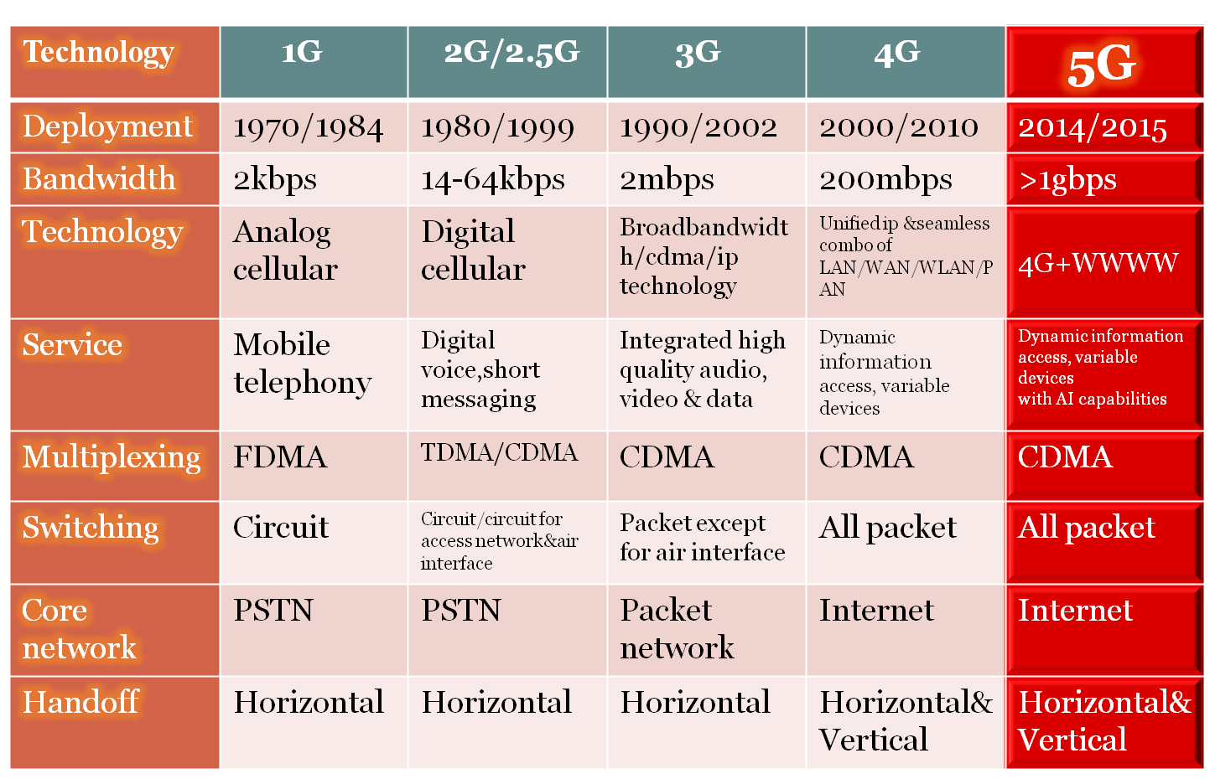
COMPARISON OF 1G TO 5G TECHNOLOGIES

Slide 10
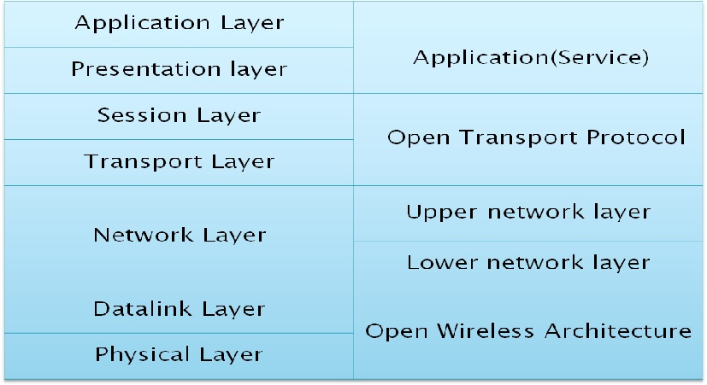

Slide 11
Open Wireless Architecture (OWA)
OSI layer 1 & OSI layer 2 define the wireless technology
For these two layers the 5G mobile network is likely to be based on Open Wireless Architecture (OWA)
Physical layer + Data link layer = OWA

Slide 12
Network Layer
All mobile networks will use mobile IP
Each mobile terminal will be FA (Foreign Agent)
A mobile can be attached to several mobiles or wireless networks at the same time
The fixed IPv6 will be implemented in the mobile phones
Separation of network layer into two sub-layers:
(i) Lower network layer (for each interface)
(ii) Upper network layer (for the mobile terminal)

Slide 13
Open Transport Protocol (OTP)
Wireless network differs from wired network regarding the transport layer
In all TCP versions the assumption is that lost segments are due to network congestion
In wireless, the loss is due to higher bit error ratio in the radio interface
5G mobile terminals have transport layer that is possible to be downloaded & installed – Open Transport Protocol (OTP)
Transport layer + Session layer = OTP

Slide 14
Application (service) Layer
Provides intelligent QoS (Quality of Service) management over variety of networks
Provides possibility for service quality testing & storage of measurement information in information database in the mobile terminal
Select the best wireless connection for given services
QoS parameters, such as, delay, losses, BW, reliability, will be stored in DB of 5G mobile
Presentation layer + Application layer = Application

Slide 15
Hardware & Software of 5G
5G Hardware:
Uses UWB (Ultra Wide Band) networks with higher BW at low energy levels
BW is of 4000 Mbps, which is 400 times faster than today’s wireless networks
Uses smart antenna
Uses CDMA (Code Division Multiple Access)
5G Software:
5G will be single unified standard of different wireless networks, including LAN technologies, LAN/WAN, WWWW- World Wide Wireless Web, unified IP & seamless combination of broadband
Software defined radio, encryption, flexibility, Anti-Virus

Slide 16
Features of 5G
High resolution for crazy cell phone users
Bi-directional large BW
Less traffic
25 Mbps connectivity speed
Enhanced & available connectivity just about the world
Uploading & Downloading speed of 5G touching the peak (up to 1 Gbps)
Better & fast solution

Slide 17

Advantages of 5G
Data BW of 1 Gbps or higher
Dynamic information access
Globally accessible
Available at low cost

Slide 18
Conclusion
3G- Operator Centric,
4G- Service Centric whereas
5G- User Centric
We have proposed 5G wireless concept designed as an open platform on different layers
The new coming 5G technology will be available in the market at affordable rates, high peak future & much reliability than preceding technologies

